Slide 1
Saif Seas Automations
Business Environmental Stragey Management Project on:-
by-
Yellapu Sai Akka Saradhi
121923901007
MBA-Fintech

Slide 2
Company at Glance
automation in the Marine Space
To Democratize robotics and automation in the marine space to build better lives for mankind
To build cutting edge products that solve today’s problems that are globally competent and locally relevant
Saif Seas water buoy is defining a new category of safety in marine. It has gone from concept to product in just 11 months. 100% Indian design and engineering, simulated up to sea state 4 and support from National Research Development Corporation under Start-Ups Intellectual Property Protection

Slide 3
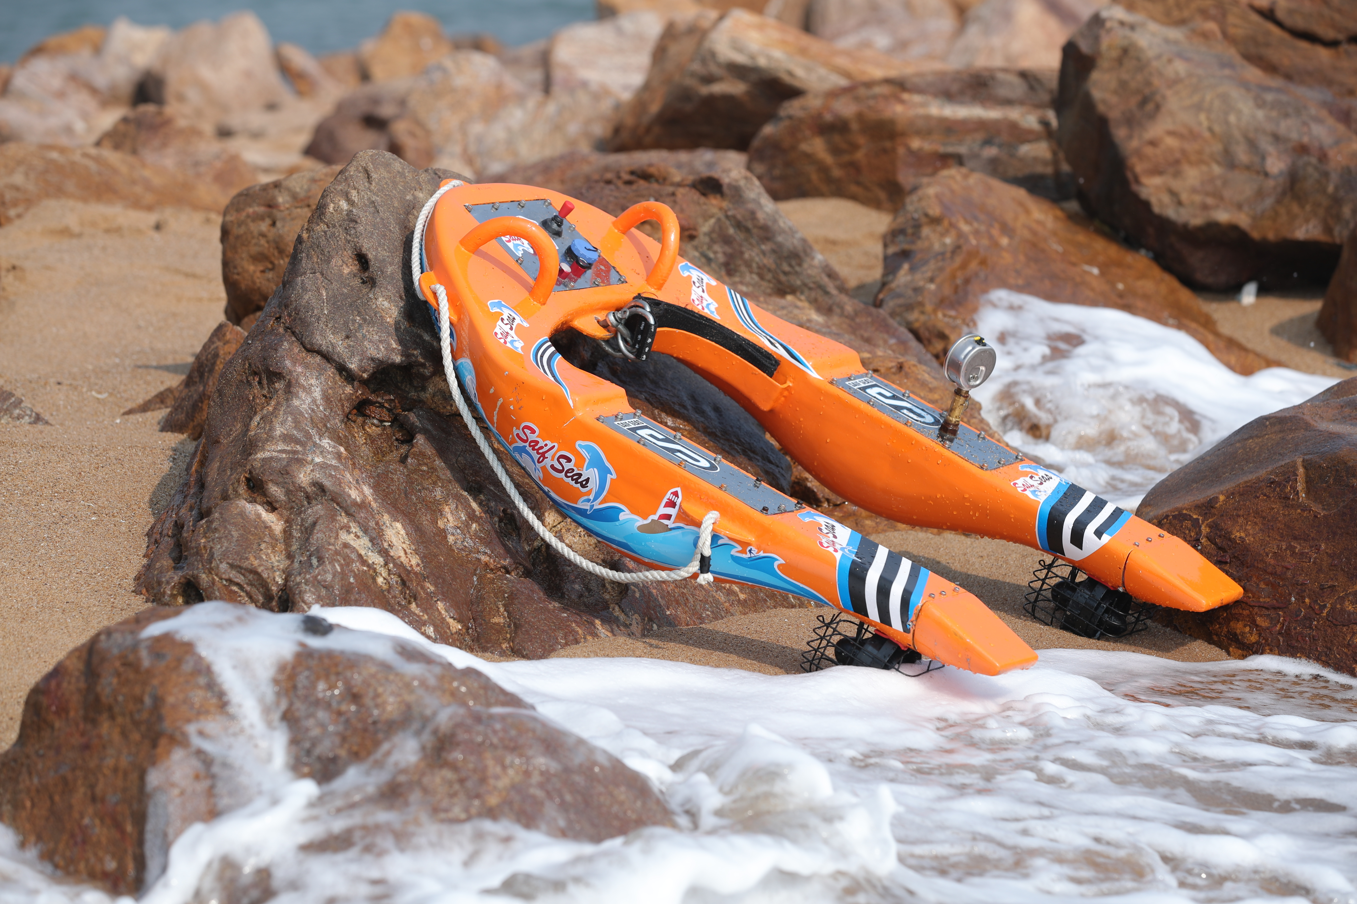
Product
Unmanned remote controlled rescue with no risk to human life in the rescue process
Fit it with HD cameras, robotic probes or weaponry and design the drone for the job
Strong 3km communication, extendable up to 10 km on request
90 mins on moderate load and 8 hours of GPS tracking

Slide 4
Financial Growth
 | ON THE DAY OF lunching product | AS OF 23TH september 2019
Number of Clients from Andhra Pradesh | 1 | 2
Number of Clients from India [Outside Andhra Pradesh] | 2 | 3
Number of Foreign/Offshore Clients | 0 | 0
s.no | ON THE DAY OF JOINING | AS OF 23TH September 2019
INCOME GENERATED | 50,000/- | 6,00,000/-
FUNDING, IF ANY | 0.5 crore from APIETA | 0.75 crore from APEITA

Slide 5
Company Revenue details
TOTAL NUMBER OF CLIENTS | NUMBER OF CLIENTS FROM AP AND REVENUE GENERATED FROM THE CLIENTS | NUMBER OF CLIENTS OUTSIDE AP BUT FROM INDIA AND REVENUE GENERATED FROM THE CLIENTS | NUMBER OF OFFSHORE/FOREIGN CLIENTS AND REVENUE GENERATED
5 | 2 CLIENTS from AP and revenue generated from the clients is 1,50,000/- per anum | 3 CLINETS from outside the AP And revenue generated from the clients is 4,00,000/- per anum | 0

Slide 6
Barriers
Need more employees.
Cost of the products.
Transportation costs high.
Need mentors who can support.
And support from investors.
Technical barriers.
Benifits
Given a good place to R&D by Govt.
And support from Government*.
And support from Indian Navy in terms of permissions.

Slide 7
Problems what I have observed.
Need HR policies.
Need assistance on marketing and sales.
Also need more space and infra.
Need more projective ideas.

Slide 8
Environmental Scaning
Strengths
weakness
Threats
Oppurtunities

Slide 9
Pestle analysis
pestle
political
economical
social
technological
Legal
enivironmental

Slide 10
Any Comments??????

